Slide 1
Computer Vision: Fine Tuning
Eng Teong Cheah

Slide 2
Objective
Transfer learning migrates the knowledge learned from the source dataset to the target dataset. Fine tuning is a common technique for transfer learning.

Slide 3
Contents
Fine Tuning

Slide 4
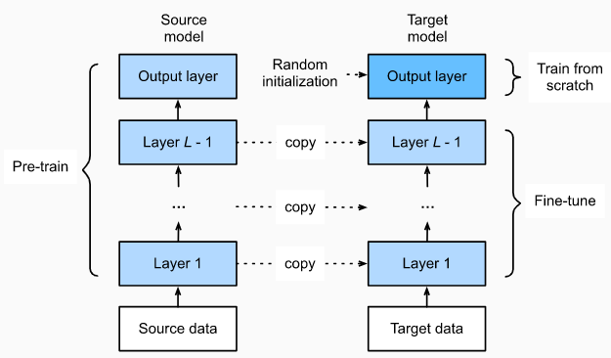
Fine Tuning

Slide 5
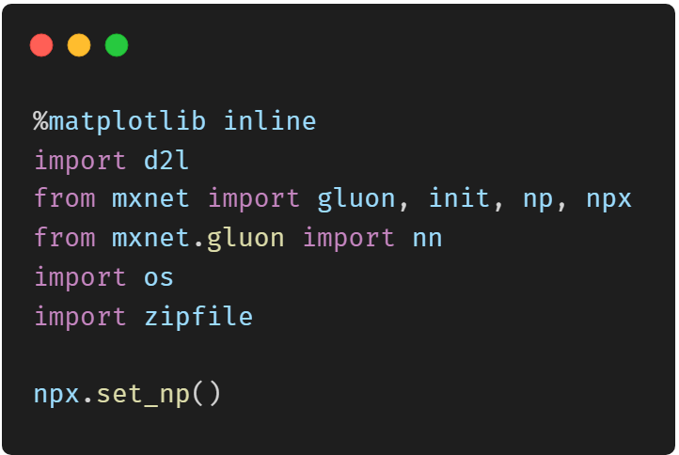
Hot Dog Recognition

Slide 6
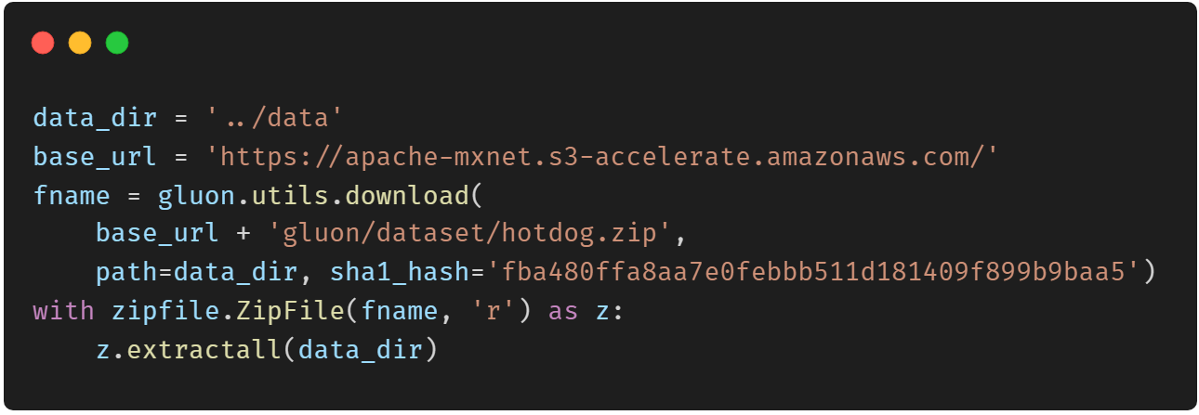
Get the Data Set

Slide 7
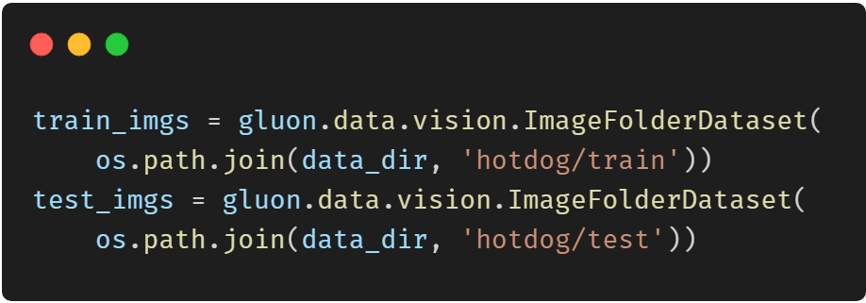
Get the Data Set

Slide 8
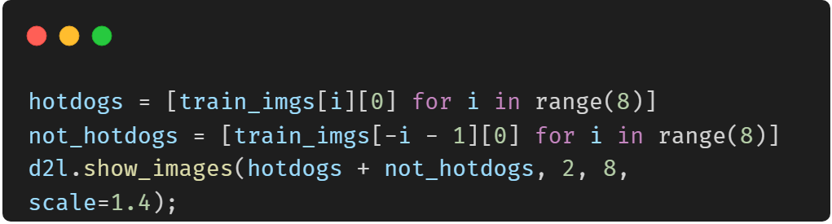
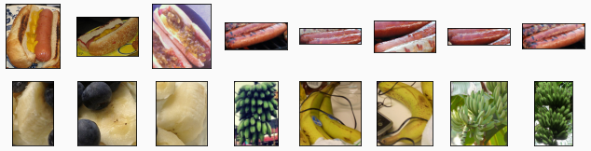
Get the Data Set

Slide 9
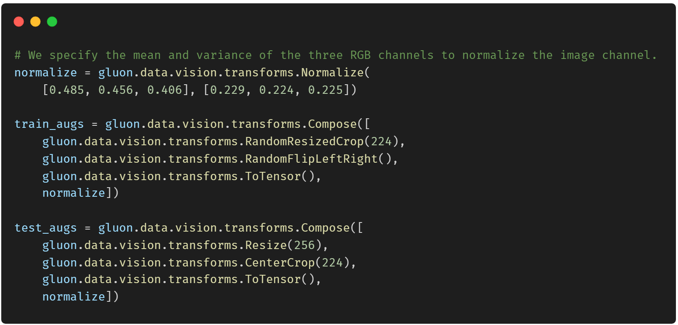
Get the Data Set

Slide 10
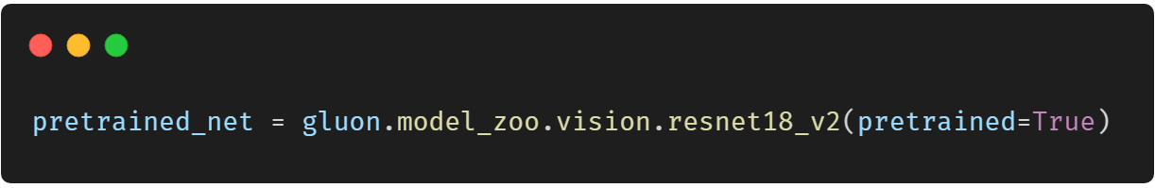
Define and Initialize the Model

Slide 11
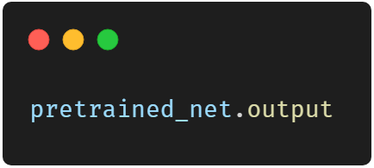
Define and Initialize the Model

Slide 12
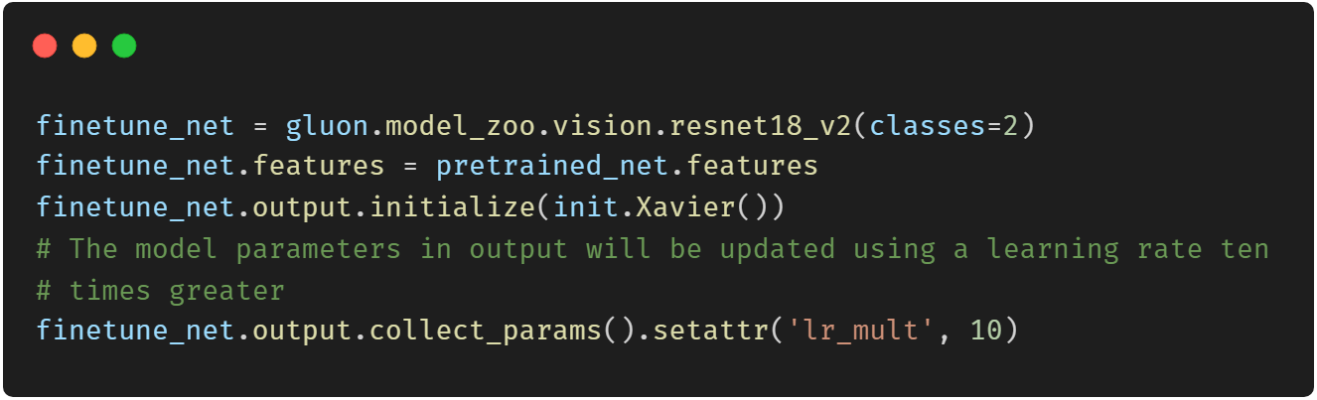
Define and Initialize the Model

Slide 13
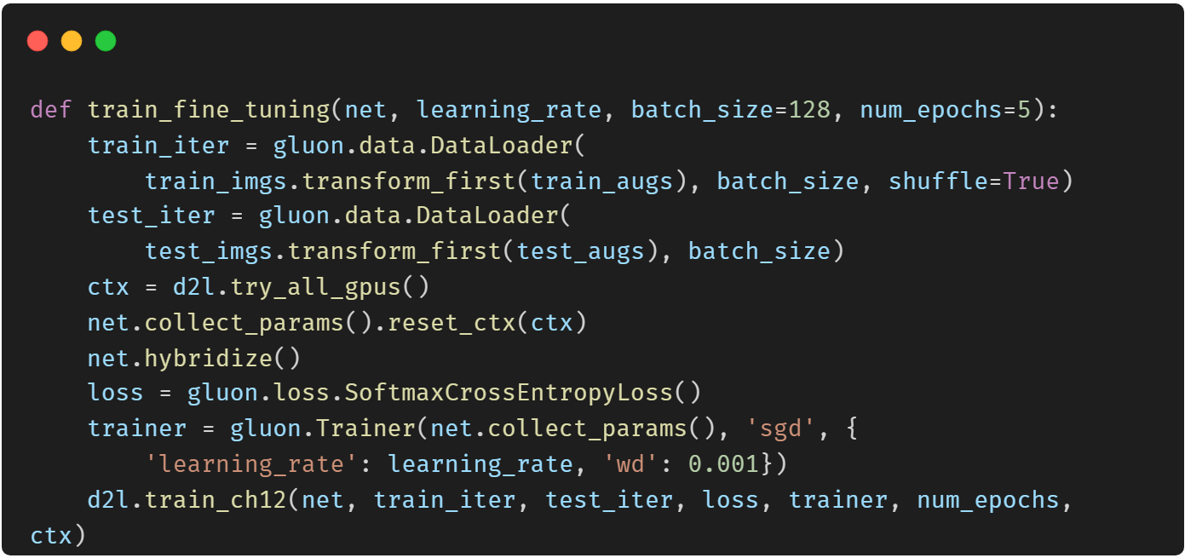
Fine Tune the Model

Slide 14
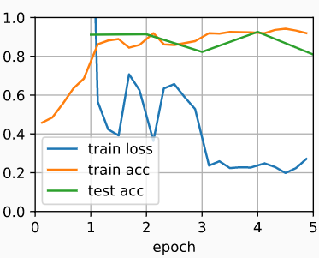
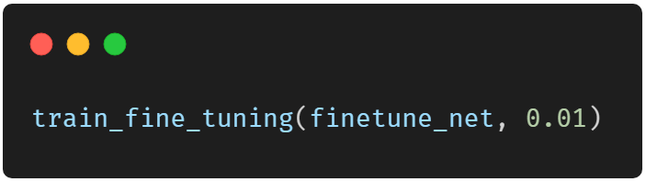
Fine Tune the Model

Slide 15
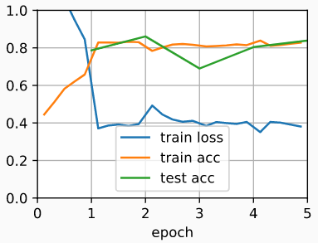
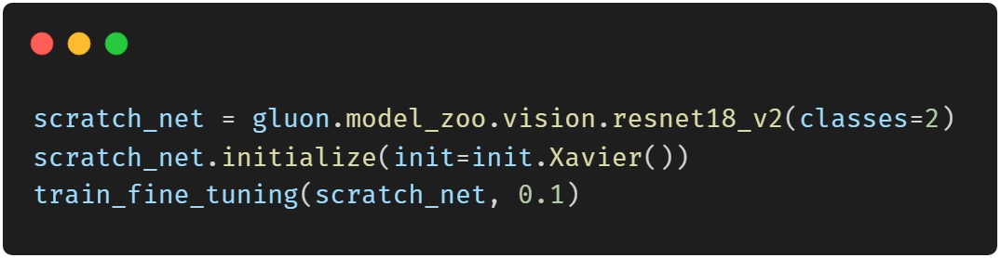
Fine Tune the Model

Slide 16
Thank You！
Does anyone have any questions?
Twitter: @walkercet
Blog: https://ceteongvanness.wordpress.com

Slide 17
Resources
Dive into Deep Learning

